Slide 1

Dental QPS CPD Event
23rd September 2015
ABuHB Update

Slide 2
ABuHB Structure Update
  Sian Millar – Divisional Director
  Andrew Matthews & Janine Cronin – ABuHB Dental Advisor
  Victoria Taylor – Interim Head of Primary Care (Contracts)
  Jodie Collins – Service Development Manager
  Paul Richards – Contracts Manager
  Andy Palmer – Contracts Support Manager
  Kathyn Thomas & Joanne Gregory – Admin Support

Slide 3
ABuHB Update
Quality Assurance Framework 2015/16
  16th September – GDPs to receive letter confirming QAS process and login details
  23rd September – QAS system goes live
  24th November – QAS system shuts down
  All submissions are to be made electronically

Slide 4
Annual Review 2014/15
As part of the Annual Review process, the Health Board is required to provide you with an annual report under Part 5, Clause 39 of the Dental Contract.
3 Year Rolling Programme
1st year of the 2nd triennial process
Visits to take place during October and November
Notes:
Annual review visits are currently conducted over a 3 year rolling programme which concluded in 2013/14. We are therefore embarking on the 1st year of the 2nd triennial process. It is anticipated that approximately 30 practices will receive a visit across the ABuHB area.
The Primary Care Team has selected practices for clinical or managerial based visits based on the following areas: exception reporting, HIW inspection process, concerns etc. Practices to be notified w/c 21/09/15 whether they have been selected for a visit.
Visits to take place during October and November 2015. GDPs will be informed by way of letter if they have been selected for an Annual Review visit.

Slide 5
Flu 2015
Occupational Health Flu clinics will commence in October 2015
Correspondence has been sent to all GDPs w/c 21/09/15 via email.

Slide 6
Integrated Oral Health Group
Strategic Group
First meeting on 29th September 2015
LOHAP
Notes:
The Oral Health Advisory Group has now been replaced with the new Integrated Oral Health Group.
This group will be a strategic group with an aim to drive the dental agenda forward and will be chaired by the Deputy Chief Operating Officer.
The first meeting will take place on 29th September 2015 and membership will include LDC, PHW, CDS, Scheduled Care and ABuHB Representation.
We will be reviewing the LOHAP at this meeting, status of the actions and refresh to include new areas of development.

Slide 7
Referral Pathways
Minor Oral Surgery
Domiciliary
Bariatric
Paediatric
Child GA/Sedation
Orthodontic
Notes:
We will be developing a guidance pack which will include all the referral pathways, flowcharts and any supporting information as discussed in LDC.

Slide 8
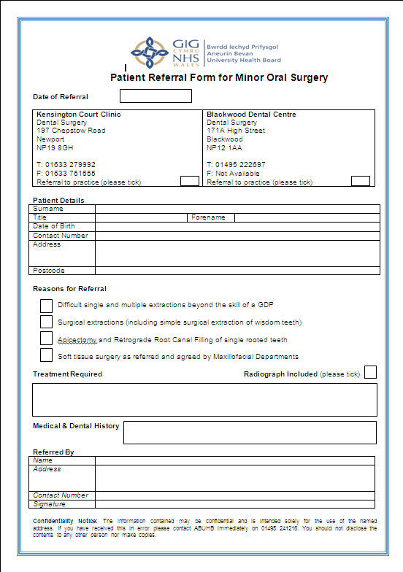
Minor Oral Surgery
Primary Care GDP-GDP Referral

Slide 9
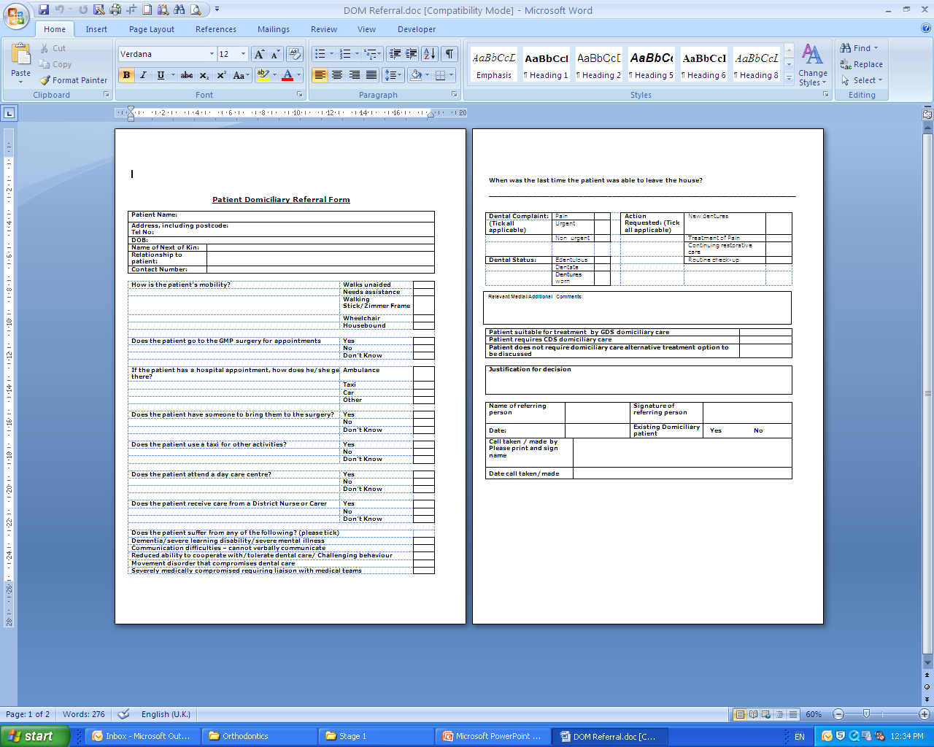
Domiciliary
.

Slide 10
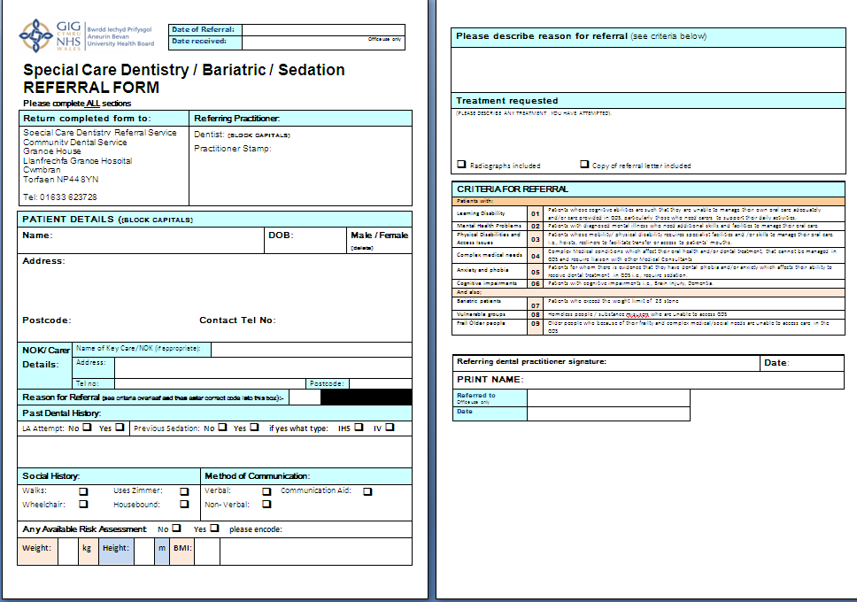
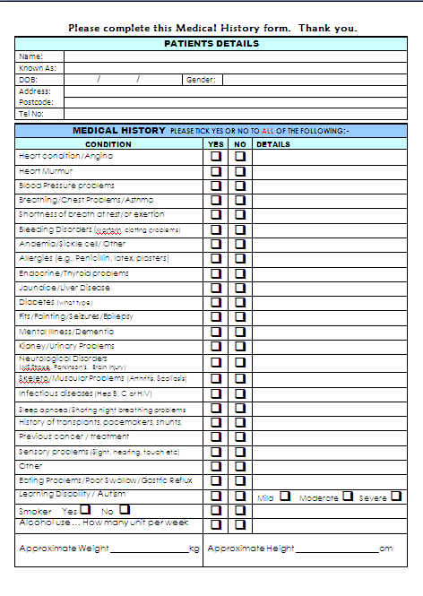
Bariatric

Slide 11
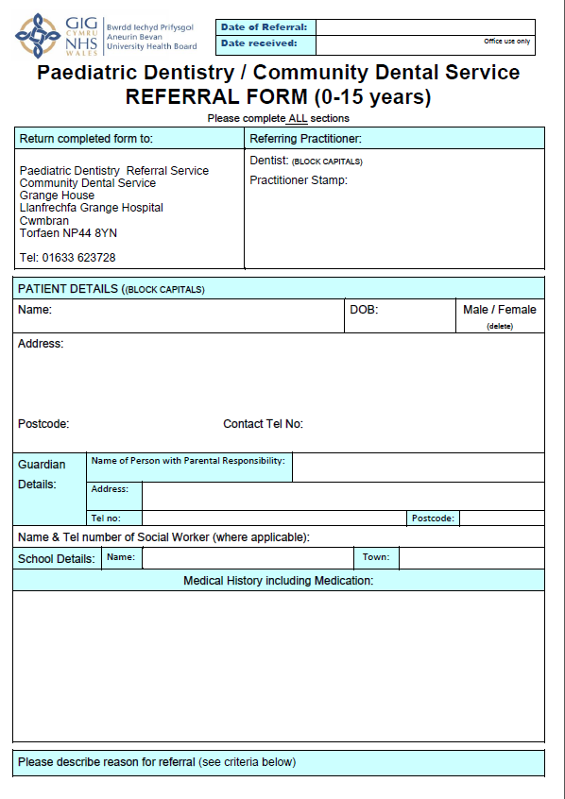
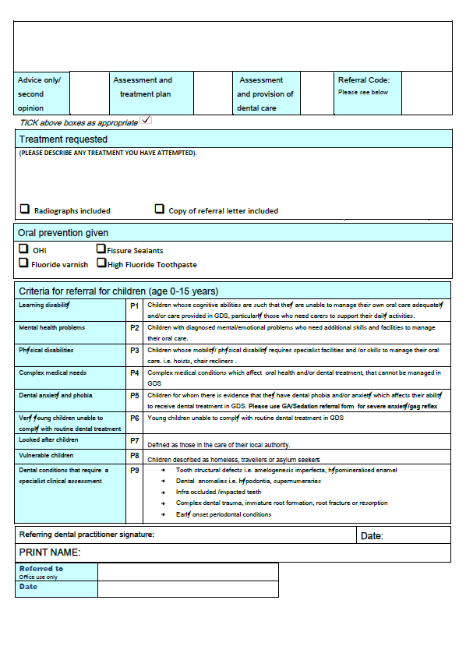
Paediatric

Slide 12
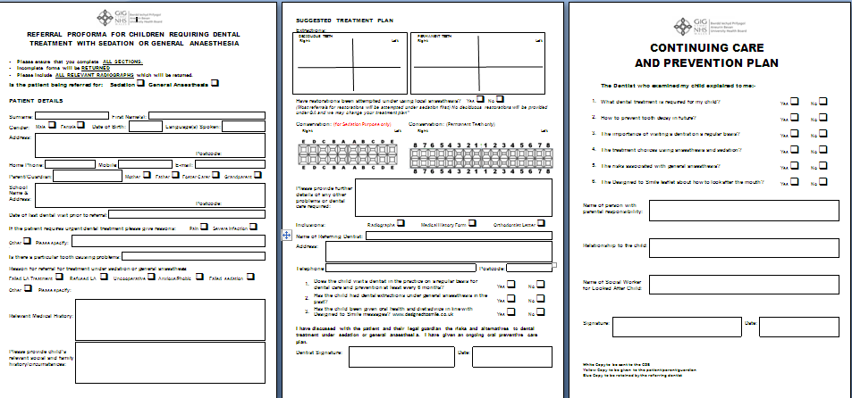
Child Sedation or GA

Slide 13
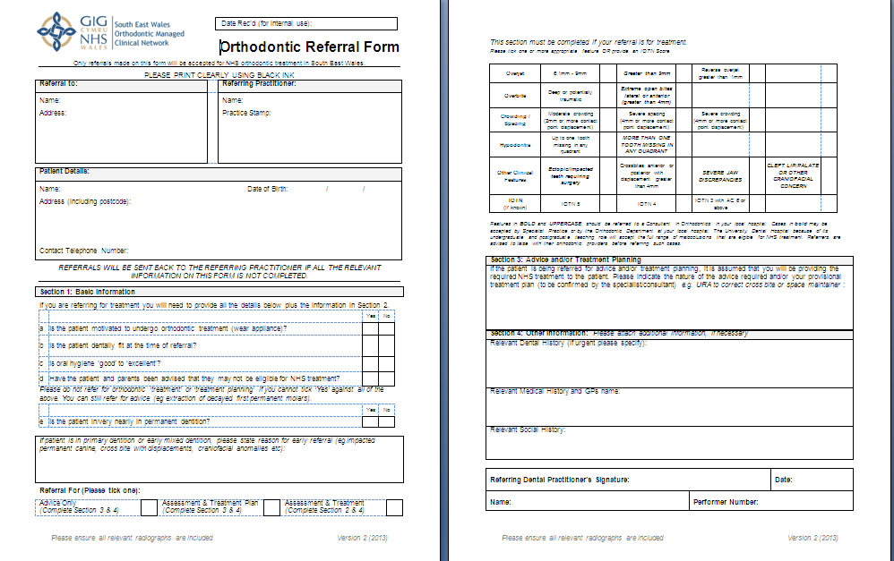
Orthodontic

Slide 14
Minor Oral Surgery
Two providers
Includes MOS sedation service (1 provider)
800 (approx) GDP to GDP referrals
494 patients from SC Pull
Oral Surgery Form being developed
Notes:
The MOS continues with the 2 providers. This now includes Minor Oral Surgery sedation, from KC.
Since April, we identified a further 494 patients from the SC waiting list. These patients have been referred since the direct GDP service has been introduced.

Slide 15

Dental Out of Hours

Slide 16
Next steps.....
Domiciliary Pilot review
SCD MCN Sedation Pathway
Notes:
PDS contracts end in April 2016 will be undertaking a review.
Developed a pathway which we will be reviewing.

